Slide 1
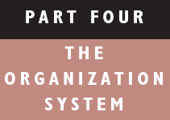
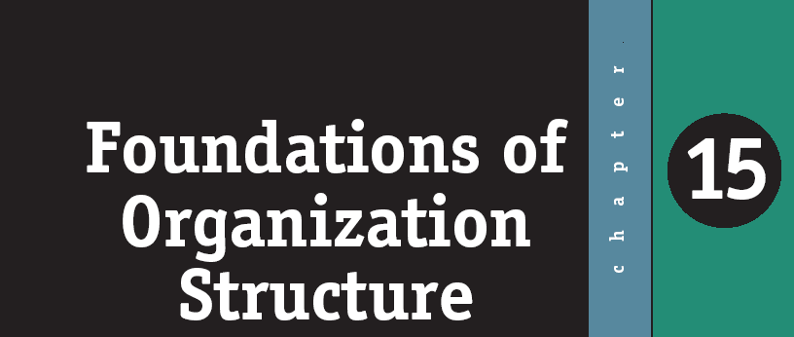
ORGANIZATIONAL BEHAVIOR

Slide 2
After studying chapter 15 and listening to class lecture,you should be able to:
L E A R N I N G O B J E C T I V E S
Identify the six key elements that define an organization’s structure.
Explain the characteristics of a bureaucracy.
Describe a matrix organization.
Explain the characteristics of a virtual organization.
Summarize why managers want to create boundaryless organizations.
Contrast mechanistic and organic structural models.
List the factors that favor different organizational structures.
Why do structures differ?

Slide 3
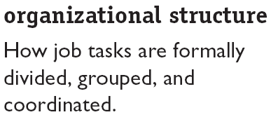
What Is Organizational Structure?
Key Elements:
Work specialization
Departmentalization
Chain of command
Span of control
Centralization and decentralization
Formalization

Slide 4
What Determines
Organizational Structure?
To what degree are tasks subdivided into separate jobs?
On what basis will jobs be grouped together?
To whom do individuals and groups report?
How many individuals can a manager efficiently and effectively direct?
Where does decision-making authority lie?
To what degree will there be rules and regulations to direct employees and managers?
Notes:
Because the structure of an organization defines how tasks are divided, grouped, and coordinated, there are six key elements that managers must consider when they design their organization’s structure: work specialization, departmentalization, chain of command, span of control, centralization or decentralization, and formalization. The slide above presents each of those elements as an answer to an important structural question.
1. Work specialization
2. Departmentalization
3. Chain of command
4. Span of control
5. Centralization and decentralization
6. Formalization

Slide 5
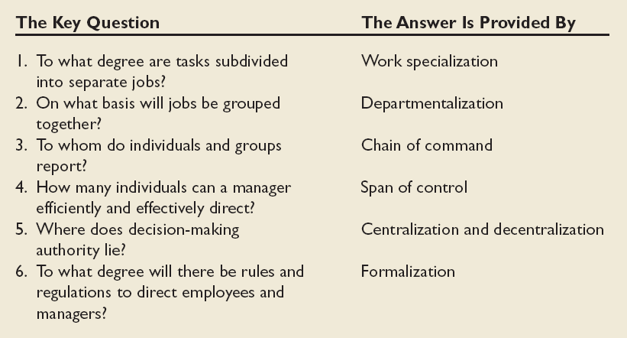
Key Design Questions and Answers for Designing the Proper Organization Structure

Slide 6

Strategy
Organization
Size
Why Do
Structures
Differ?
Technology
Environment
Notes:
Strategy and structure are closely related. Most strategy frameworks focus on three dimensions—innovation, cost minimization, and imitation—and on the structural design that works best with each. If management makes a significant change to its organization’s strategy, then the structure must be modified to accommodate and support the change.
Considerable evidence supports the premise that an organization’s size has a significant effect on its structure. However, the relationship is not linear. Size affects structure at a decreasing rate, and the impact becomes less important as an organization expands. Once an organization has around 2,000 employees, it is already fairly mechanistic. So, adding 500 workers will not have much impact. But adding 500 workers to a company with only 300 employees is likely to result in a shift to a more mechanistic structure.
Technology refers to how an organization transfers its inputs into outputs. Routine activities are automated and specialized, and non-routine activities are customized. Studies show that organizational structures adapt to technology. So, standardized technologies characterize centralized structures, and customized activities characterize decentralized structures. In addition, the relationship between technology and structure is moderated by the degree of formalization. Since both formal regulations and centralized decision making are control mechanisms, management can substitute one for the other. Routine technologies should be associated with centralized control, therefore, when formalization is low. If formalization is high, however, routine technology can be accompanied by decentralization.
Environmental uncertainty greatly influences organizational structure. There are three key dimensions in the environment of any organization: capacity, the degree to which it can support growth; volatility, the degree of its instability; and complexity, the degree of heterogeneity and concentration among its elements. Management will attempt to minimize uncertainty by adjusting the organization’s structure. Scarce, dynamic, and complex environments require flexible, organic structures; whereas, abundant, stable, and simple environments require mechanistic structures.

Slide 7
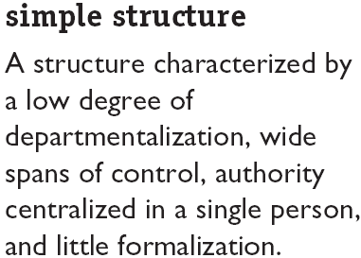
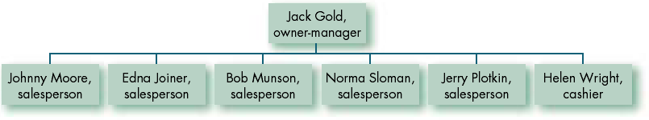
Common Organization Designs
A Simple Structure:
Jack Gold’s Men’s Store

Slide 8
Organizational Chart of a Manufacturing Firm
Board
member
Board
member
Board
member
Board
member
Chief
Executive
Officer
Legal
counsel
President
V.P Sales/
Marketing
V.P Human
Resources
V.P
Production
V.P Research
and Development
Industrial
Products
Director-
Sales
Consumer
Products
Director-
Sales
Industrial
Products
Director-
Human
Resources
Consumer
Products
Director-
Human
Resources
Industrial
Products
Director-
Production
Consumer
Products
Director-
Production
Industrial
Products
Director-
R&D
Consumer
Products
Director-
R&D
Western
Region
Industrial
Products
Sales
Manager
Eastern
Region
Industrial
Products
Sales
Manager
Western
Region
Consumer
Products
Sales
Manager
Eastern
Region
Consumer
Products
Sales
Manager
etc.
etc.
etc.
etc.
etc.
etc.
etc.
etc.
etc.
etc.
Notes:
3

Slide 9
Tall versus Flat Organizations
Chief
Executive
Tall Organization
Tall hierarchy
Flat Organization
Chief
Executive
Relatively narrow
span of control
Flat hierarchy
Relatively wide
span of control
Notes:
4

Slide 10
A Product Organization
Chief
Executive
Officer
President
Product
Group 1
Product
Group 2
Product
Group 3
Pro-
duction
Sales
R&D
Acctg.
Pro-
duction
Sales
R&D
Acctg
Pro-
duction
Sales
R&D
Acctg.
Notes:
6

Slide 11
A Horizontal Organization
Overall Manager
Adviser
Team responsible for core process
(e.g., generating and fulfilling orders)
Team responsible for core process
(e.g., product development)
Team responsible for core process
(e.g., flow of materials)
Objective:
Reduced
cycle time
Objective:
More new
products
Objective:
Enhanced
product
quality
Adviser
Adviser
Notes:
8

Slide 12
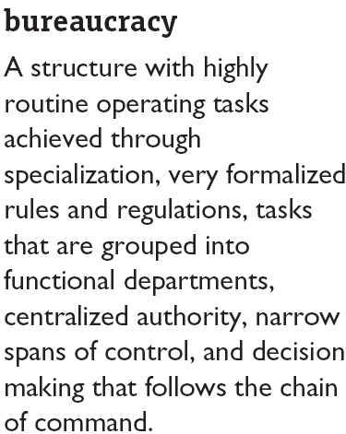
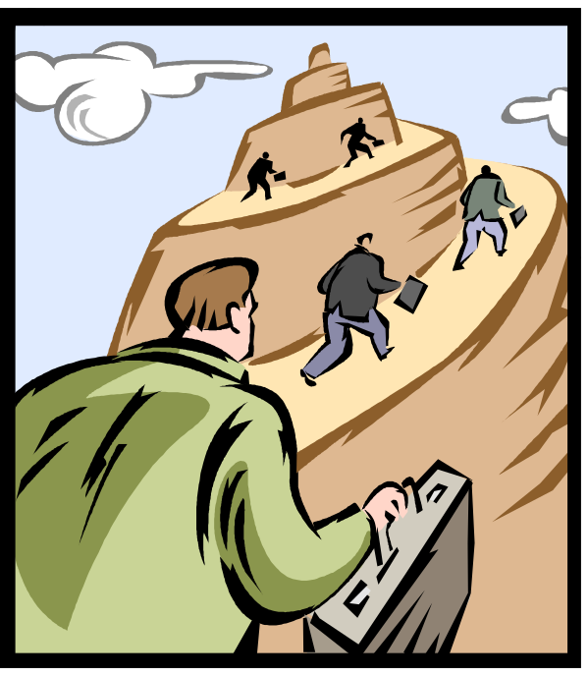
Common Organization Designs

Slide 13
The Bureaucracy
Strengths
  Functional economies of scale
  Minimum duplication of personnel and equipment
  Enhanced communication
  Centralized decision making
Weaknesses
  Subunit conflicts with organizational goals
  Obsessive concern with rules and regulations
  Lack of employee discretion to deal with problems

Slide 14
Decentralization: Benefits When Low and When High
Low Decentralization
(High Centralization)
Eliminates the additional responsibility not desired by people performing routine jobs
Permits crucial decisions to be made by individuals who have the “big picture”
High Decentralization
(Low Centralization)
Can eliminate levels of management, making a leaner organization
Promotes greater opportunities for decisions to be made be people closest to problems
Table 12-1
Notes:
5

Slide 15
The Matrix Structure
Cross-Functional
Coordination
Clear
Accountability
Dual Chain
of Command
Allocation
of Specialists

Slide 16
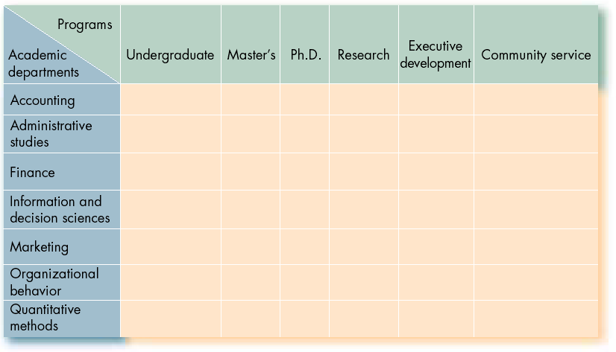
Matrix Structure (College of Business Administration)
(Director)
(Dean)
Employee

Slide 17
A
Matrix Organization
President
Farm Machinery
Division
Functional
authority
Project
authority
Production
department
Legal
department
Engineering
department
Accounting
department
Project
Alpha
manager
Production
support
group
Legal
support
group
Engineering
support
group
Accounting
support
group
Project
Beta
manager
Production
support
group
Legal
support
group
Engineering
support
group
Accounting
support
group
Project
Gamma
manager
Production
support
group
Legal
support
group
Engineering
support
group
Accounting
support
group
Notes:
7

Slide 18
Mechanistic vs. Organic Designs
Structure
Dimension
Stability
Specialization
Formal rules
Authority
Mechanistic
Change unlikely
Many specialists
Rigid rules
Centralized in a few top people
Organic
Change likely
Many generalists
Considerable flexibility
Decentralized, diffused throughout the organization
Table 12-2
Notes:
9

Slide 19
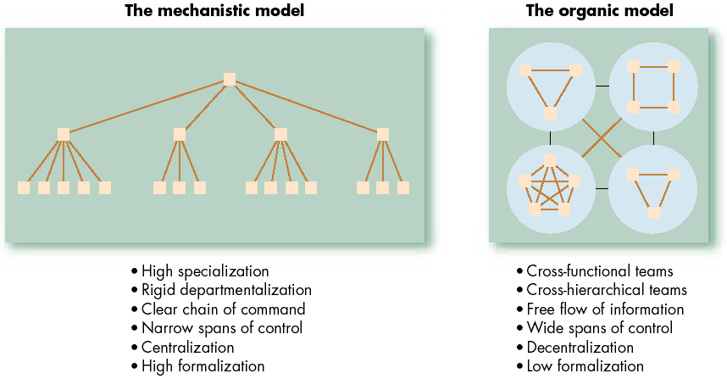
Mechanistic Versus Organic Models

Slide 20
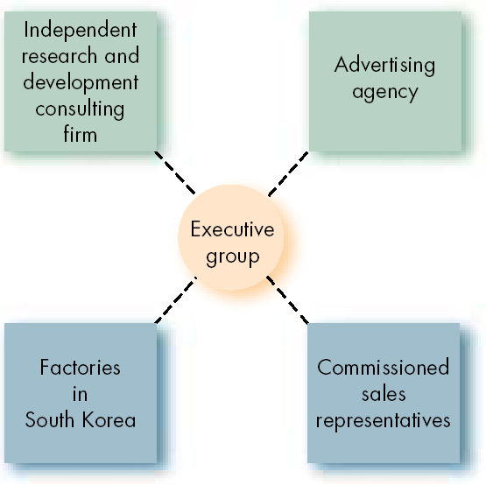
A Virtual Organization

Slide 21
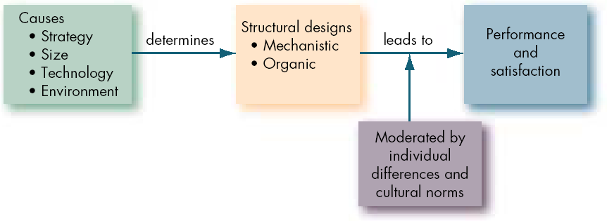
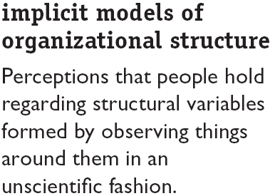
Organization Structure: Its Determinants and Outcomes

Slide 22
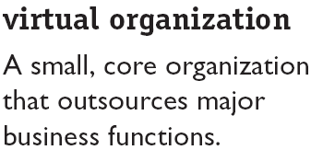
New Design Options
Concepts:
Provides maximum flexibility while concentrating on what the organization does best.
Disadvantage is reduced control over key parts of the business.

Slide 23
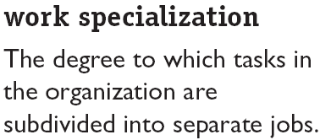
What Is Organizational Structure? (cont’d)
Division of labor:
Makes efficient use of employee skills
Increases employee skills through repetition
Less between-job downtime increases productivity
Specialized training is more efficient
Allows use of specialized equipment

Slide 24
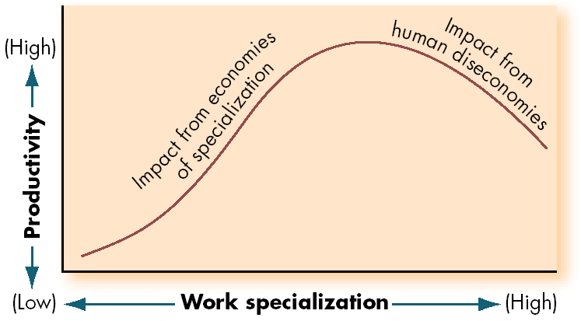
Economies and Diseconomies of Work Specialization
15-2
E X H I B I T

Slide 25
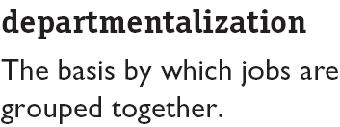
What Is Organizational Structure? (cont’d)
Grouping Activities By:
Function
Product
Geography
Process
Customer

Slide 26
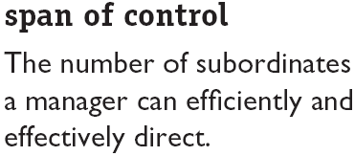
What Is Organizational Structure? (cont’d)
Narrow Span Drawbacks:
Expense of additional layers of management.
Increased complexity of vertical communication.
Encouragement of overly tight supervision and discouragement of employee autonomy.
Concept:
Wider spans of management increase organizational efficiency.

Slide 27
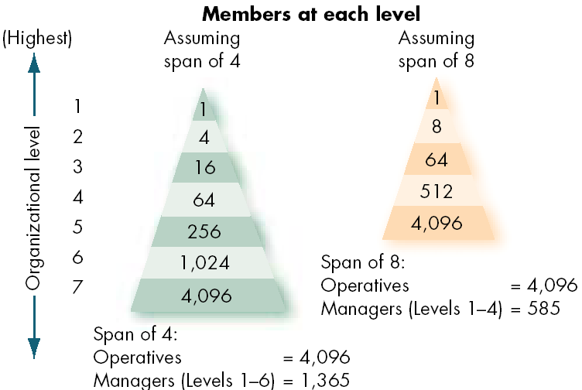
Contrasting Spans of Control
15-3
E X H I B I T

Slide 28
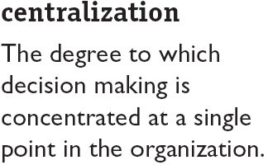
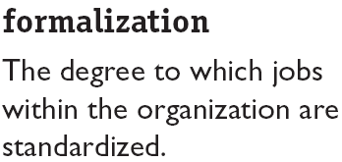
What Is Organizational Structure? (cont’d)

Slide 29
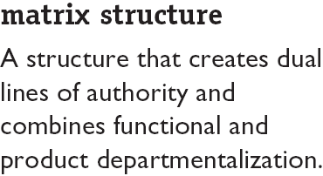
Common Organization Designs (cont’d)
Key Elements:
Gains advantages of functional and product departmentalization while avoiding their weaknesses.
Facilitates coordination of complex and interdependent activities.
Breaks down unity-of-command concept.

Slide 30
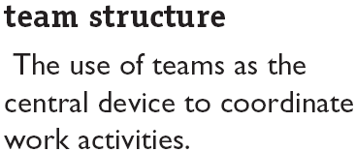
New Design Options
Characteristics:
Breaks down departmental barriers.
Decentralizes decision making to the team level.
Requires employees to be generalists as well as specialists.
Creates a “flexible bureaucracy.”

Slide 31
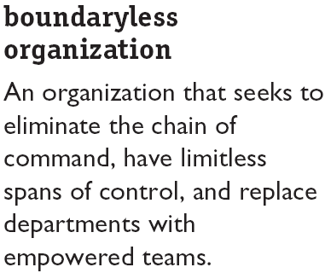
New Design Options (cont’d)
T-form Concepts:
Eliminate vertical (hierarchical) and horizontal (departmental) internal boundaries.
Breakdown external barriers to customers and suppliers.

Slide 32
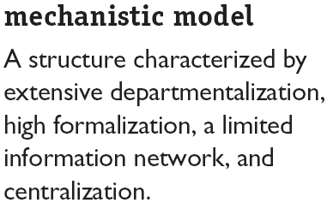
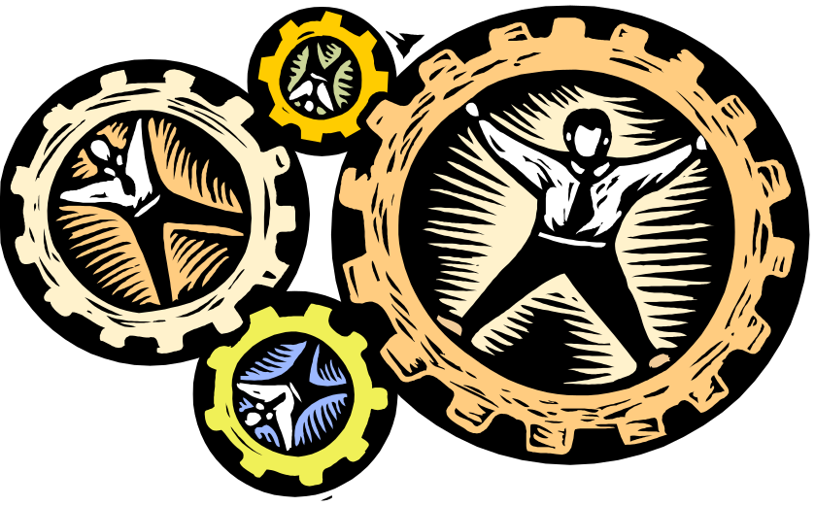
Why Do Structures Differ?

Slide 33
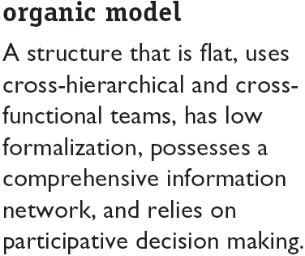

Why Do Structures Differ?

Slide 34
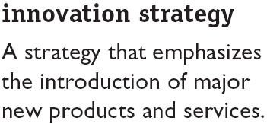
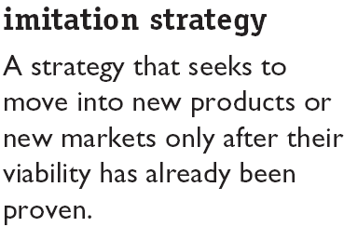
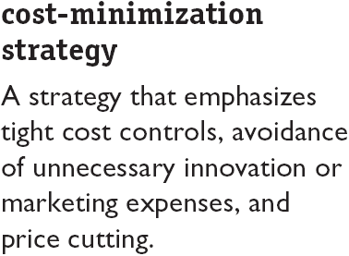
Why Do Structures Differ? – Strategy

Slide 35
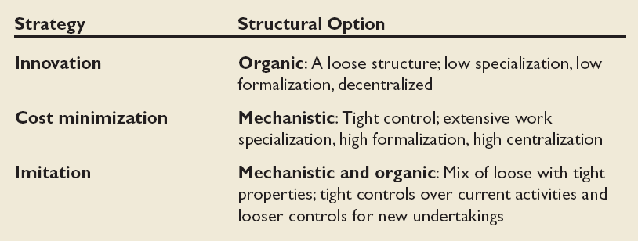
The Strategy-Structure Relationship
15-9
E X H I B I T

Slide 36
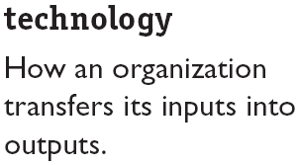
Why Do Structures Differ? – Technology
Characteristics of routineness (standardized or customized) in activities:
Routine technologies are associated with tall, departmentalized structures and formalization in organizations.
Routine technologies lead to centralization when formalization is low.
Nonroutine technologies are associated with delegated decision authority.

Slide 37
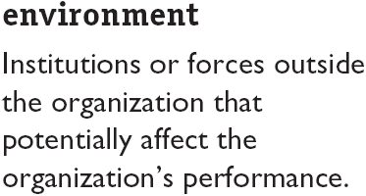
Why Do Structures Differ? – Environment
Key Dimensions:
Capacity: the degree to which an environment can support growth.
Volatility: the degree of instability in the environment.
Complexity: the degree of heterogeneity and concentration among environmental elements.

Slide 38
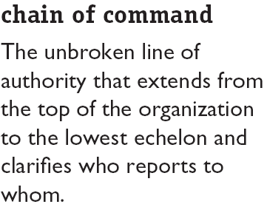
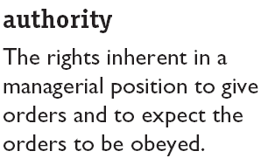
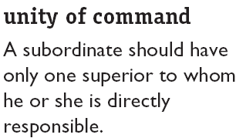
What Is Organizational Structure? (cont’d)

Slide 39
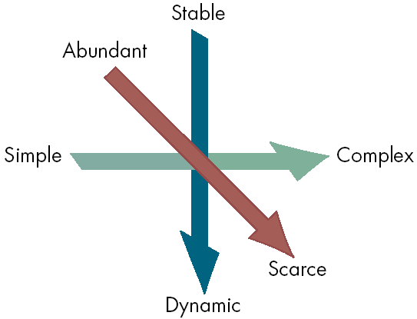
The Three Dimensional Model of the Environment
Volatility
Capacity
Complexity
15-10
E X H I B I T

Slide 40
Organizational Designs and Employee Behavior
Research Findings:
Work specialization contributes to higher employee productivity, but it reduces job satisfaction.
The benefits of specialization have decreased rapidly as employees seek more intrinsically rewarding jobs.
The effect of span of control on employee performance is contingent upon individual differences and abilities, task structures, and other organizational factors.
Participative decision making in decentralized organizations is positively related to job satisfaction.

